Slide 1

Personal Learning in a Connected World:
Learning and Performance Support Systems
Stephen Downes
September 18, 2014
Riyadh, Saudi Arabia

Slide 2
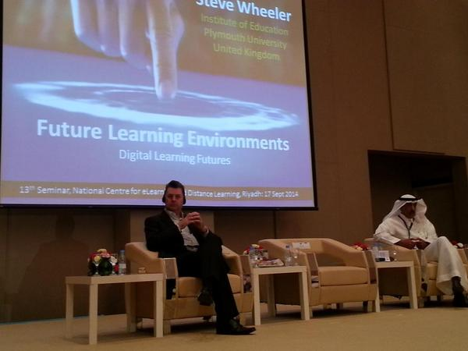
Yes, we can predict the future
I took this picture yesterday knowing I would want to use it in this presentation today.

Slide 3
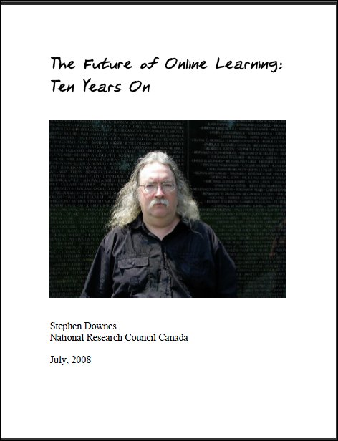
In 1998 I predicted…
High-speed wireless access
Importance of audio and video
The iPad (even got the name right)
Learning objects (called ‘modules’)
Learning management systems
Personalized education
http://www.downes.ca/future/
http://www.downes.ca/me/mybooks.htm

Slide 4

How do we predict the future?
We predict the future the way we understand the past: by reading the signs
This is also how we understand the world in general, and how we learn

Slide 5
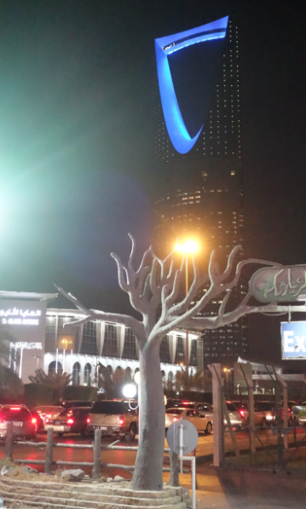
Learning is a form of recognition
It’s what we do naturally, as humans, from the day we are born
And it’s something that grows and evolves into a complex set of basic literacies, including pattern recognition, critical thinking, action and behaviour, awareness of context, inference and imagination, and change (the ‘critical literacies’)

Slide 6

The learning process is interactive
Aggregate
Remix
Repurpose
Feed Forward
To teach is to model and demonstrate, to learn is to practice and reflect

Slide 7

This is the basis of our approach to learning technologies
1999 – Learning communities
2001 – The learning marketplace
2004 – E-Learning 2.0
2005 – Learning Networks / Connectivism
2005 – Open Educational Resources
2008 – MOOC
2010 – Personal Learning Environments
2013 – LPSS

Slide 8
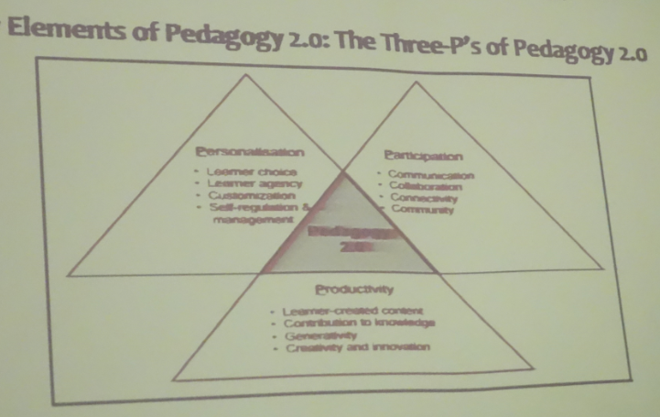
You can also see it in Pedagogy 2.0
Bader A. Alsaleh - http://halfanhour.blogspot.com/2014/09/bader-alsaleh-september-17-riyadh.html

Slide 9
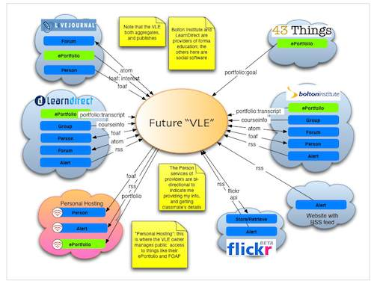
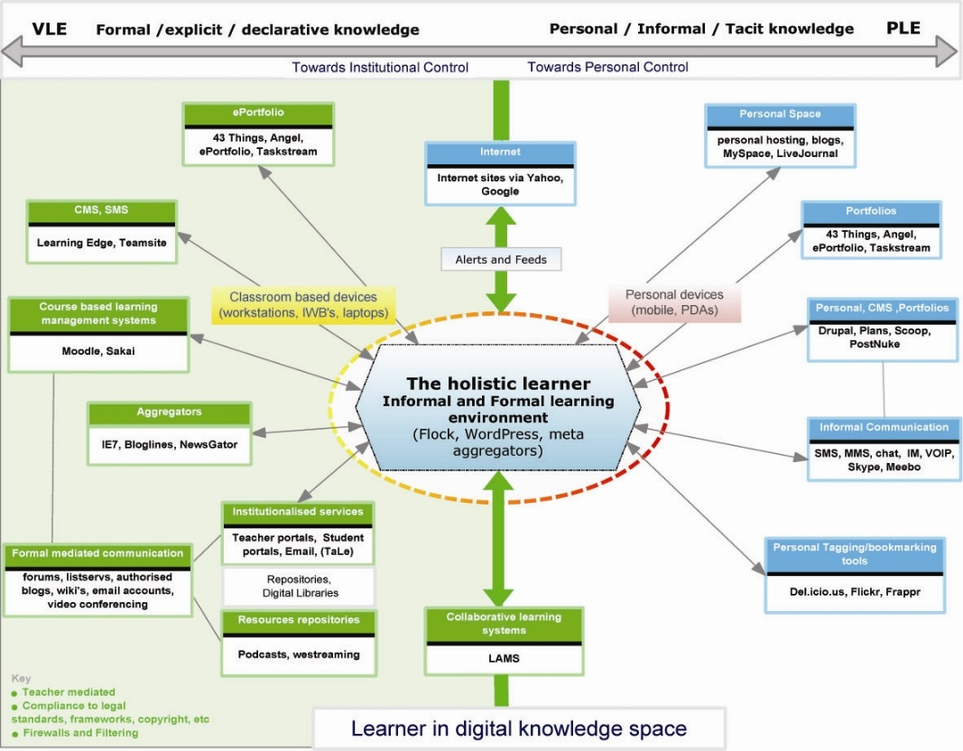
The design is based on putting the learner at the center
Scott Wilson (left), Tim Hand (right)
https://www.google.com/search?q=ple+diagrams
http://www.edtechpost.ca/ple_diagrams/index.php/mind-map-3

Slide 10
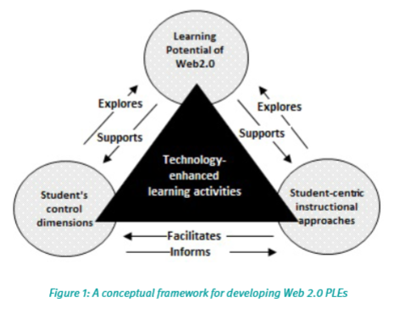
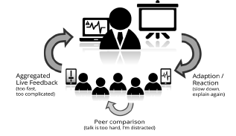
This is known generally as the ‘Personal Learning Environment’ (PLE)
The PLE as concept
Web 2.0 supported PLEs
Game-based approaches and ‘quantified self’
Mobile learning
The PLE as an assessment tool
http://en.wikipedia.org/wiki/History_of_personal_learning_environments
http://pleconf.org/2013/files/2014/07/v3.0_PLE_Conference2013_ResearchReport_BeuthUniversity_MonashUniversity.pdf
Images: Ebrahim Rahimi, Jan van den Berg, Wim Veen; Benedikt S. Morschheuser, Verónica Rivera-Pelayo, Athanasios Mazarakis,
Valentin Zacharias

Slide 11
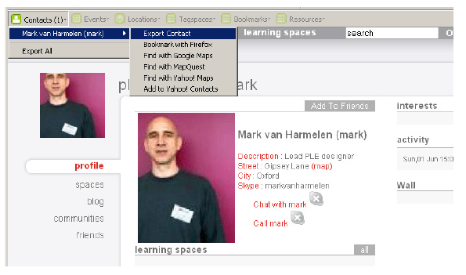
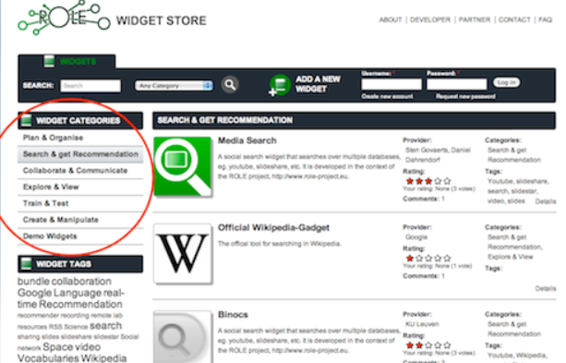
Relevant Projects
Manchester PLE Project
Responsive Open Learning Environments (ROLE) http://www.role-project.eu/
Known http://withknown.com/
Learning Locker http://learninglocker.net/
Mahara https://mahara.org/
http://personalis.wikispaces.com/PLE+Projects

Slide 12
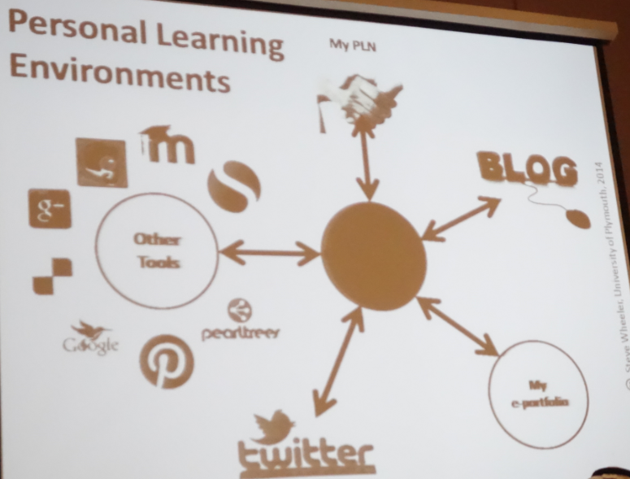
We are focused at the technology at the center
?
http://halfanhour.blogspot.com/2014/09/steve-wheeler-september-17-riyadh-notes.html

Slide 13
Learning and Performance Support Systems
WAVE
Workflow Analysis, Visualization and Enhancement
MOOC-REL
Massive Open Online Course Ressources Éducatives Libres
MINT
Multimodal INteractive Trainer
RRN
PCL
PLR
ACDR
PLA
WORLD
DATA
EXTERNAL
DATA Services
EXTERNAL
APPS
COMMON PLATFORM
Services, Communications, Management
MATS
Program
Technologies
NRC Programs
Government
Departments
It’s a network of personal learning environments…
… connected to a large array of learning services

Slide 14
Core Technology Development Projects
Learning services network and marketplace
Automated skills development and recognition
Lifetime management of learning and training records and credentials
Personal learning assistant to view, update and access training
Resource Network
Learning Assistant
Automate Skills Dev.
Personal Learning Records
Learning as a cloud service and deep integration with external systems
Notes:
the solution would consist of the main components as shown on the slide
Learning as a Cloud Service - will create a distributed learning layer, which is mechanism for working with data no matter where it is stored, through desktop, mobile and other devices.
Resource Repository Network – will create a resource graph from multiple sources and multiple formats including live and dynamic data such as oilfield data, refinery instrumentation, or Oil and Gas market information.
Personal Learning Record - this project will define how we represent, capture, and leverage user activity, including ratings, test results, performance measures, and the like, in a distributed learning and work environment.
Automated Competence Development And Recognition – whereas existing recommender systems depend on manually defined metrics, this system will detect new and emerging competences and automatically assess employee performance.
Personal Learning Assistant – this project will develop an integrated learning appliance, a mechanism for looking up or finding references or resources inside other programs or environments.

Slide 15
LPSS Core Projects

Slide 16
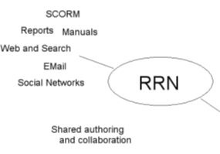

Resource Repository Network
Manage and discover list of sources and resources
Maintain authentication and credentials
Support APIs and metadata standards
Gather, analyze and sort resources and/or metadata

Slide 17
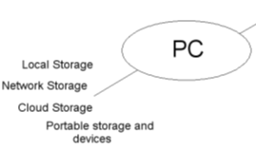
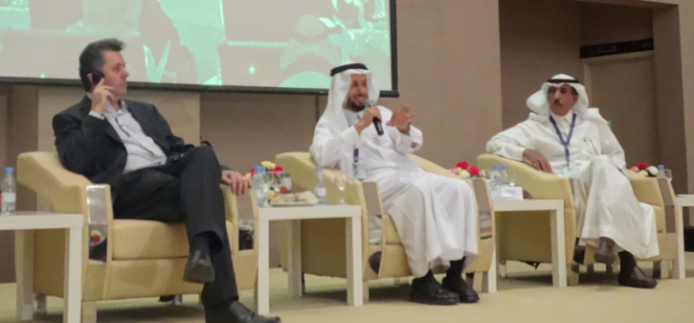
Personal Cloud
Manage list of local and remote storage systems
Maintain security, encryption, authentication and credentials
Include local or personal device storage
Manage and synchronize resource sets and data

Slide 18
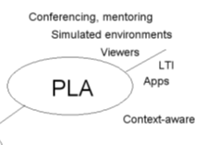
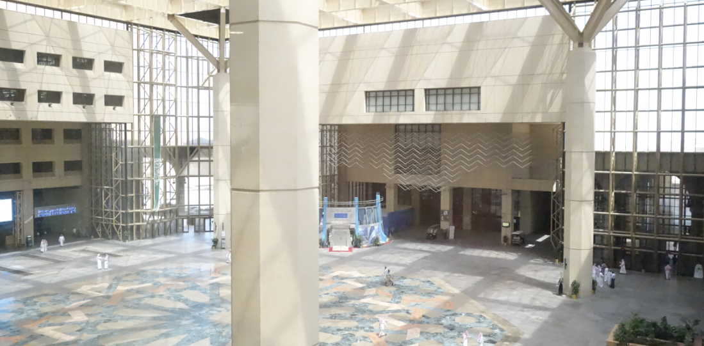
Personal Learning Assistant
Collect contextual information for system
Display resources of various formats, inclusing SCORM, LTI, etc.
Support (scaffolded) authoring environments
Project LPSS capacity into external software and devices

Slide 19
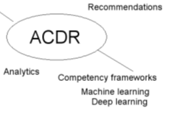
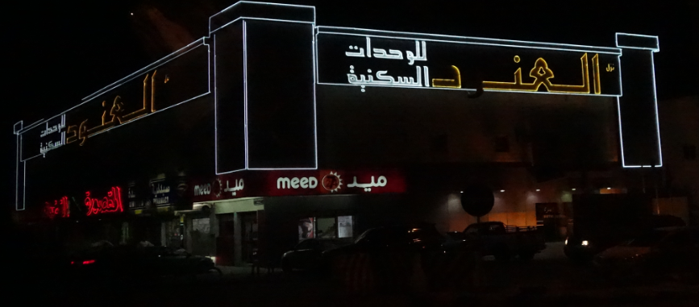
Competency Recognition and Development
Import or create competency definitions
Analyze interactions for skills and learning gaps
Support development of learning plans
Provide resource and service recommendations

Slide 20

Personal Learning Record
Collect full record of interactions with all resources, external systems
Support learning activity data exchange formats (eg. xAPI)
Collect and present a person’s personal portfolio
Display certifications and credentials (eg. badges)
Maintain 3rd party certification

Slide 21
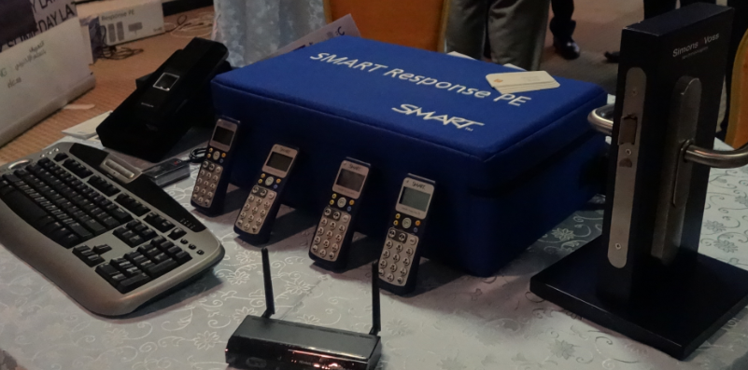
Implementation – from MOOC to Personal Learning
MOOC-REL (OIF)
ALECSO
MINT
SHARE
Badges
Simulator
Workplace T&D

Slide 22
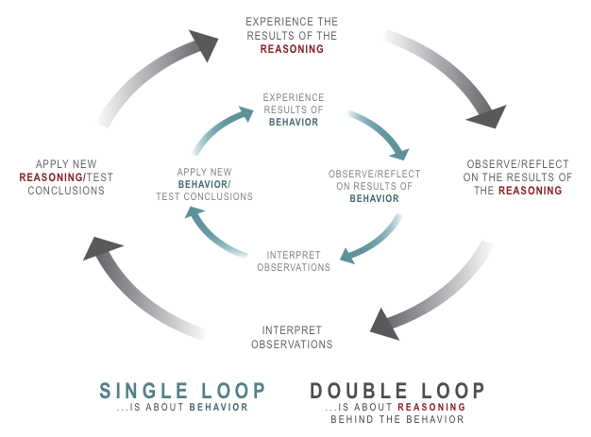
Implementation Projects
Ultimately, the objective is to support individual learning in a network
http://integralleadershipmanifesto.com/manifesto/making-subject-object/

Slide 23

Launch
Limited beta starting at the end of September
Hosted service offered at http://lpss.me
Slow roll-out of capacity over next 18 months
Development of partnerships and capacity building projects

Slide 24
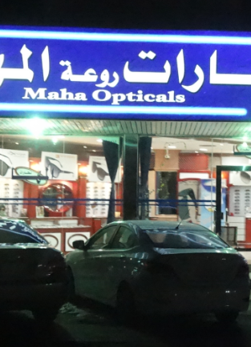
Why is this important?
Because technology is not just a tool
It gives us the capacity to do new things (the ‘affordances argument’)
It represents an extension of our perceptions (the McLuhan argument)
“We shape technology, and then technology shapes us”

Slide 25
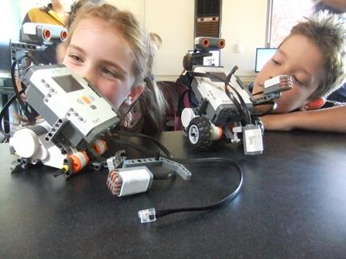
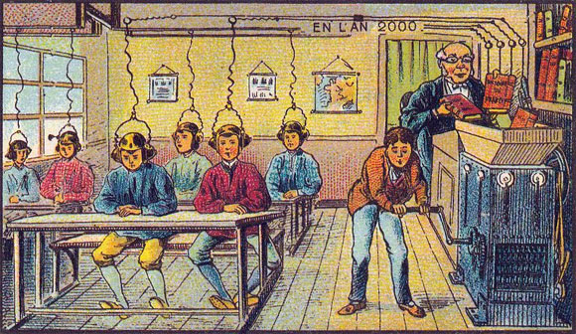

What kind of learner we become depends on what kind of learning technology we choose
http://singularityhub.com/2012/10/15/19th-century-french-artists-predicted-the-world-of-the-future-in-this-series-of-postcards/
http://www.alter-inc.com/wearable.html
http://www.keithcotps.sa.edu.au/Learning.htm

Slide 26
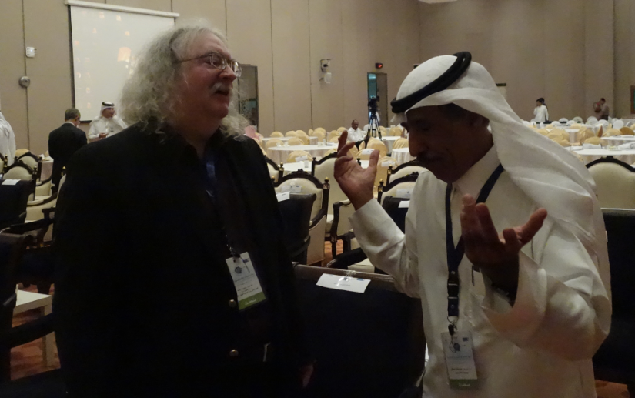
Stephen Downes
http://www.downes.ca

